Slide 1
ST
Lecture#7

Slide 2
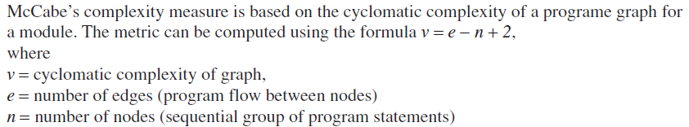
Cyclomatic Complexity

Slide 3
For Strongly Connected Graph

Slide 4
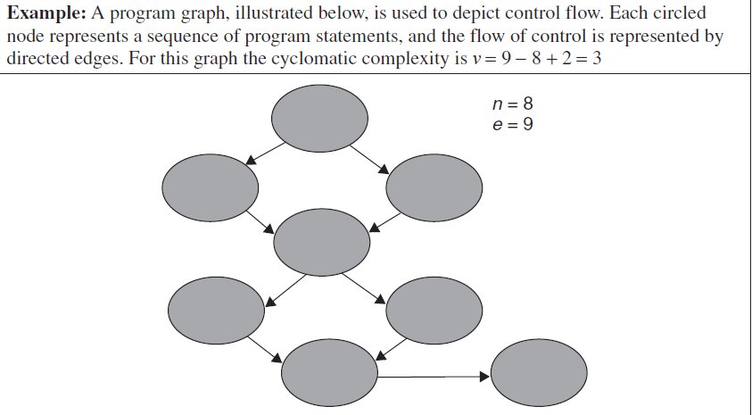

Slide 5
Another Method to Measure Complexity
Number of decision Nodes+1

Slide 6
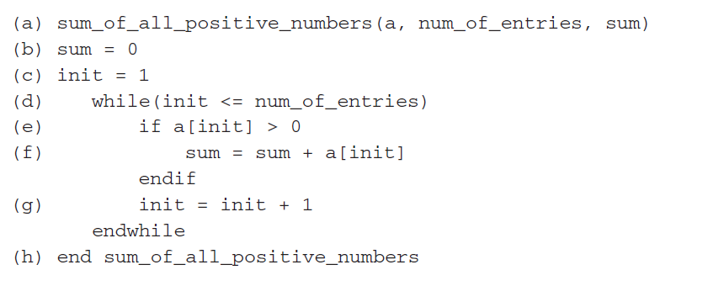
Example

Slide 7
What is the use of this measure?

Slide 8
Basis Path Coverage
This value gives the number of independent paths in the basis set , an upper bound for the number of tests to ensure that each statement and both sides of every condition is executed at least once.

Slide 9
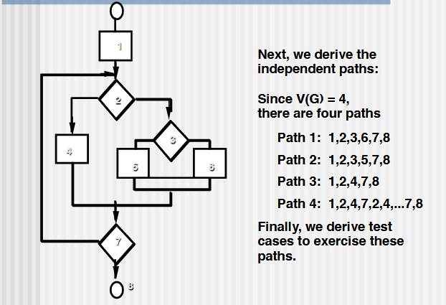

Slide 10
What to do next?

